Slide 1

Machine Learning
INSAID Project
GPS Dataset

Slide 2
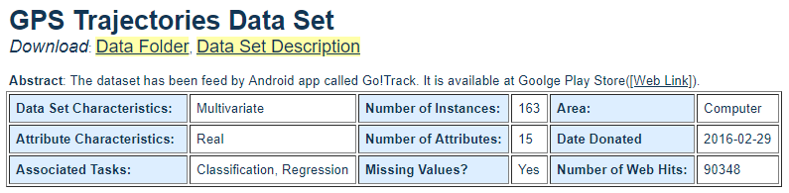
Dataset Overview
Citation Request: The first was presented in BRACIS (4th Brazilian Conference on Intelligent System). The paper was accepted but not published yet. The other paper was submitted to AT&T (IJCAI-16). The last paper is about the dataset. https://archive.ics.uci.edu/ml/datasets/GPS+Trajectories Variables used 1. Andriod ID - it represents the device used to capture the instance; 2. Speed of Travel - it represents the average speed of individual travelling (Km/H) 3. Distance - it represent the total distance (Km) 4. Rating - if volunteers move to some place and face traffic jam, maybe they will evaluate 'bad'. (3- good, 2- normal, 1-bad). 5. Bus Rating - (0 - Empty bus, 1 – very few people in bus, 2 - The bus is not crowded, 3- The bus is crowded. ) 6. Weather Rating - it is another evaluation parameter. (0 - Normal, 1- raining, 2- sunny). 7. Mode of transport - (1 - car, 2-bus)

Slide 3
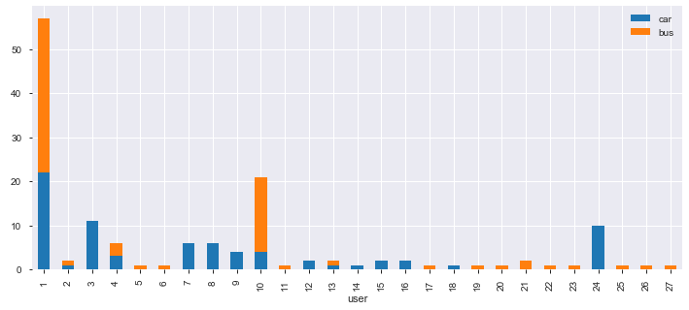
Exploratory Data Analysis
From the Insights gained from 27 users 76 times Car was used 70 times Bus was used Total Car users are 15 Total Bus users are 17 Users who use car and bus both are 5

Slide 4
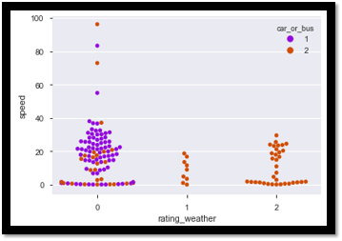
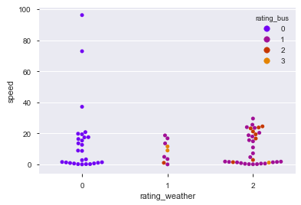
Exploratory Data Analysis
Plot speed vs weather (For car & bus)
Insights after plotting speed vs weather vs bus rating Bus is crowded during the rains and when its sunny; Speed of bus looks constant in all type of weather
Insight after plotting speed vs weather (For car & bus) Bus is crowded during the rains and when its sunny; Speed of bus looks constant in all type of weather
We also understood: Average travel by car (Time = 0.28 hrs, Distance = 6 Kms, Speed = 21.2 Kms/hour) Average travel by car (Time = 0.21 hrs, Distance = 3.54 Kms, Speed = 16.8 Kms/hour)

Slide 5
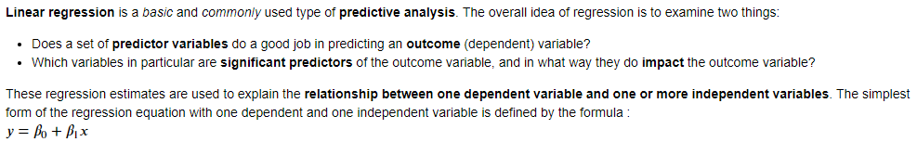
Linear Regression
Factors impacting Speed of travel (Y - Dependent variable) Explanatory variable: X1 = Distance, X2 = Weather rating, X3 = Car or bus With Linear Regression Analysis: we derived following equation Y(Distance) = -0.02896 + 0.6988755 x (Speed) - 0.0261084 x(raining) + 0.002456 (Clear Sky) + 0.005896 x (Bus/car) For Train data RMSE: 0.7095411 R-Square: 0.49245216 Adjusted R-Square: 0.47365409 For Test data RMSE : 0.7884044 R-Square: 0.39531583 Adjusted R-Square values: 0.2945351
With Feature Selection of X1 = Distance, X2 = Weather rating (Clear Sky) Y(Distance) = -0.029605 + 0.7025068 x (Speed) + 0.0108098 (Clear Sky) For Train data RMSE: 0.709983 R-Square: 0.4918191 Adjusted R-Square: 0.48257950 For Test data RMSE : 0.78909341 R-Square: 0.3942585 Adjusted R-Square values: 0.34766306

Slide 6
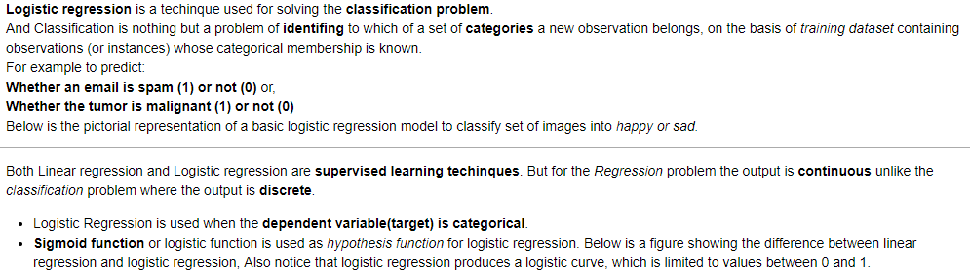

Logistic Regression
We filter users who use car and bus both & find probability based on weather & distance, if they will use a car or bus? Data was split into (70, 3) With Threshold as .05 Accuracy score : 0.8333333 With Threshold as .90 Accuracy score change was: 0.88888888

Slide 7
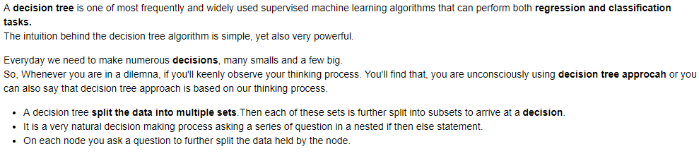

Decision Tree
With Decision Tree can we analyzed following: Filter users who use car and bus both & identify when they use car and when they use bus when compared to Distance, Rating, weather, bus rating. Accuracy Score is 50% Where as tree has dual roots of Sunny followed by Rating as good with gini as .5, with further split to rating normal and distance until leafs. No further Girdsearch analysis was perfomed as data set is small

Slide 8
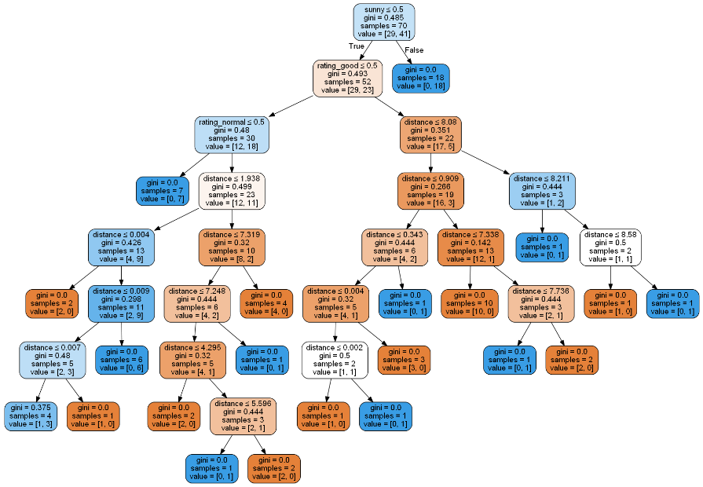
Decision Tree

Slide 9
Questions (if any)
End of Presentation
Send Email to Omsarmalkar@gmail.com

